Slide 1
EECE 419 Final Prototype
Maintenance Instruction Application for BC Hydro
Group 5
April 1st, 2014
Notes:
Jag 8~9mins

Slide 2
Outline
Video
Client Info & Problem
Solution
Demo
Formal Testing
Project Challenges
Reflection & Recommendations
Q&A
Notes:
Jag
~ 1 min

Slide 3
Supplementary Documentation
Supplementary documentation is provided in a binder, and the following artifacts are present
Scope
Functional requirements
Non-Functional requirements
Use cases
Test cases
Architecture
Design
Constraints
Risk
Schedule
Budget
traceability/Roadmap
Problem Management (Bug list, open issues)
Notes:
Waa

Slide 4
The Client & The Problem
Client is Mattias Gibbs, engineer at BC Hydro
Need to handle maintenance on hundreds of machines across various locations
BC Hydro uses forms called Maintenance Instructions (MI)
Technicians fill out forms by hand on site during inspection
Completed MIs are reviewed by a foreman
Completed and reviewed forms stored in filing cabinets
*
4
Notes:
Jag
~ 2 min

Slide 5
Issues of Current Process
Searching for forms is tedious and inefficient
Technicians do not fully complete MIs
Difficult to analyze data using software like Excel
No way to easily attach additional information
Technicians use whatever form is printed out, not necessarily the latest revision
Forms get lost between completion and filing
*
5
Notes:
Jag
~ 2 min

Slide 6
Solution
Switch from paper based process to digital process
Technicians fill out MIs on iPad and submit for review
Foremen review and approve MIs on iPad
Engineers use a web application to view completed MIs
Able to search for specific MI data
Engineers create MI templates using the web application

Slide 7
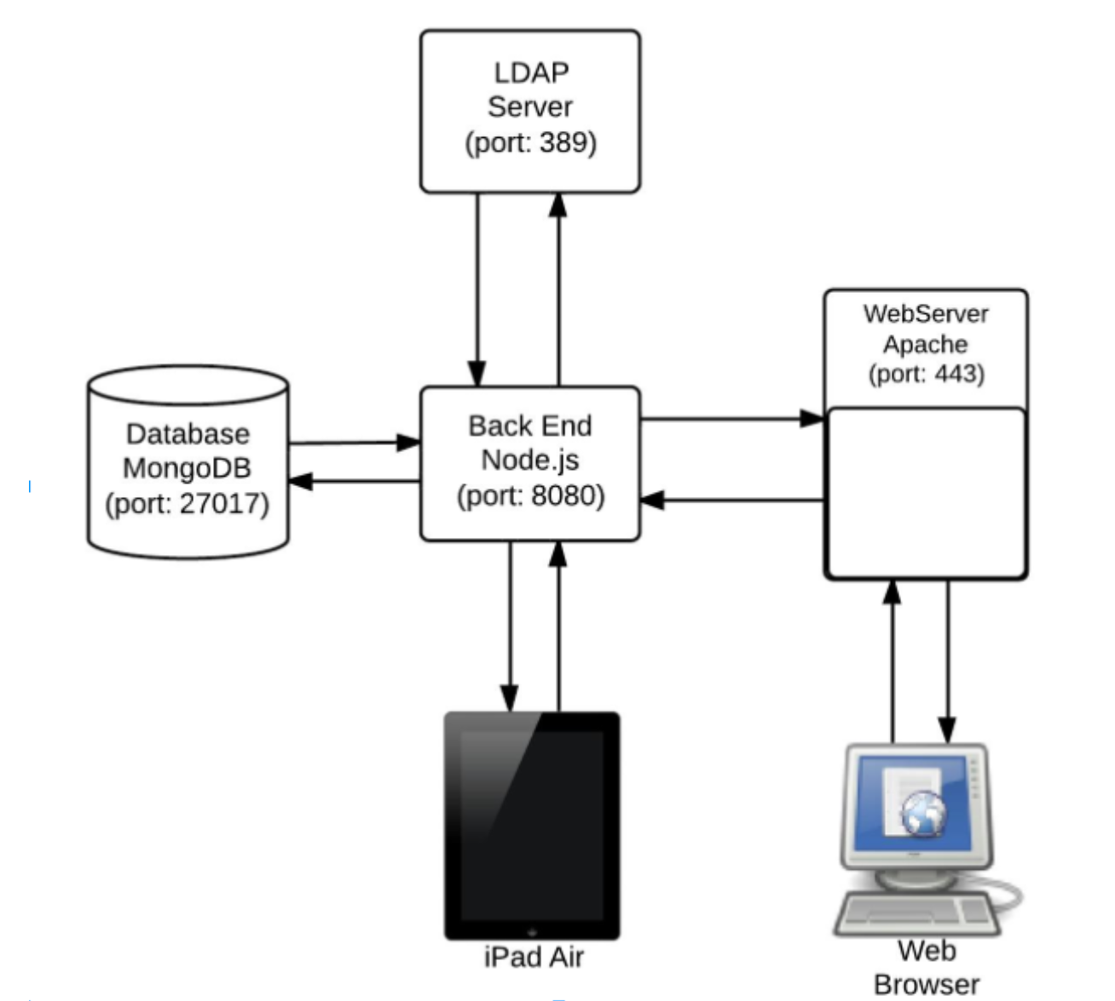
Project Architecture
*
7
Notes:
Jag
~ 2 min

Slide 8
Use Cases
Completing MIs
Creating new MI templates
Modifying existing MI templates
Search existing MI submissions
Alert Engineers of MI issues
Review MI and upload to server
Notes:
Kent

Slide 9
DEMO
*
*
9
Notes:
Start w/ Moe
Present them With demo schedule.
5~6mins
Now we would like to give a demo of our work.
Infront of you is our demo schdeule
demo the system as a whole.

Slide 10
Formal Testing
Test functional and nonfunctional requirements
Black box, white box and automated testing
Traceability matrix used to keep track of requirements, use cases and corresponding tests
Test components separately and test the system as a whole
Test tools include:
Robomongo (Database)
Postman (Backend API)
OCUnit (iPad App)
Web Browser/Console (Web Application)

Slide 11
Formal Testing Goals
Testing goal was to ensure implementation satisfied requirements
Direct performance (speed, load times etc.) were not required from the client
*
11
Notes:
Jag
~ 2 min

Slide 12
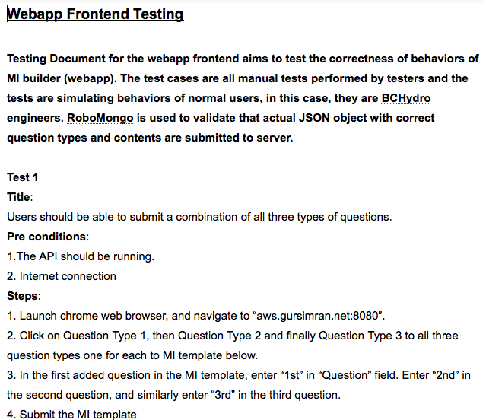
Formal Testing Example

Slide 13
Project Challenges
Keeping track of different versions of templates
Client communication after relocation
Handling media across all 3 platforms
Managing customer requests during different prototypes
*
13
Notes:
Jag
~ 2 min

Slide 14
Formal Recommendations
Hire firm to perform heuristic evaluation
Switch to a SQL database
Involve technicians in design of iPad UX
Leverage existing internal web applications as a base for the engineers' web application
Utilize web framework to better handle data efficiently (EmberJS, AngularJS, Knockout)
Add drag and drop UI builder for creating and editing templates
Add SAP Integration and exporting to Excel
*
14
Notes:
Jag
~ 2 min

Slide 15
Client Sign-off
Handing off Github repositories
Handing off project design artifacts
Client did not request user documentation
All issues and bugs being tracked will be handed off
*
15
Notes:
Jag
~ 2 min

Slide 16
Questions?
*
*
16
Notes:
Jag

Slide 17
Risk Management
First Step: Classification
By Category (User, Product/Service or Technical)
By Impact
By frequency of occurrence
By Severity
We compute a “Risk Factor” for each risk based on the 4 attributes
For each risk, we as a team discuss whether the risk should be:
Accepted
Mitigated (and how)
Avoided
Transferred

Slide 18
Non-functional Requirements
Security
Use LDAP for User Authentication
Auditability
No requirement from BC Hydro
Deployability
Web Application will be hosted on BC Hydro’s servers
iPad application will be distributed using BC Hydro’s enterprise account
Client Documentation
Engineering Design Documents
Training
At this time, there is no expectation to provide training

Slide 19
Automated Testing
Used automated testing to verify some of the functional requirements for the iPad App.
Used OCunit to write unit test cases and execute them automatically.
Maintain the test suite on the github repository and add new tests as new features are added.
Rerun the test suite after the addition of new features to make sure old functionality still works (regression testing).
*
19
Notes:
Jag
~ 2 min

Slide 20
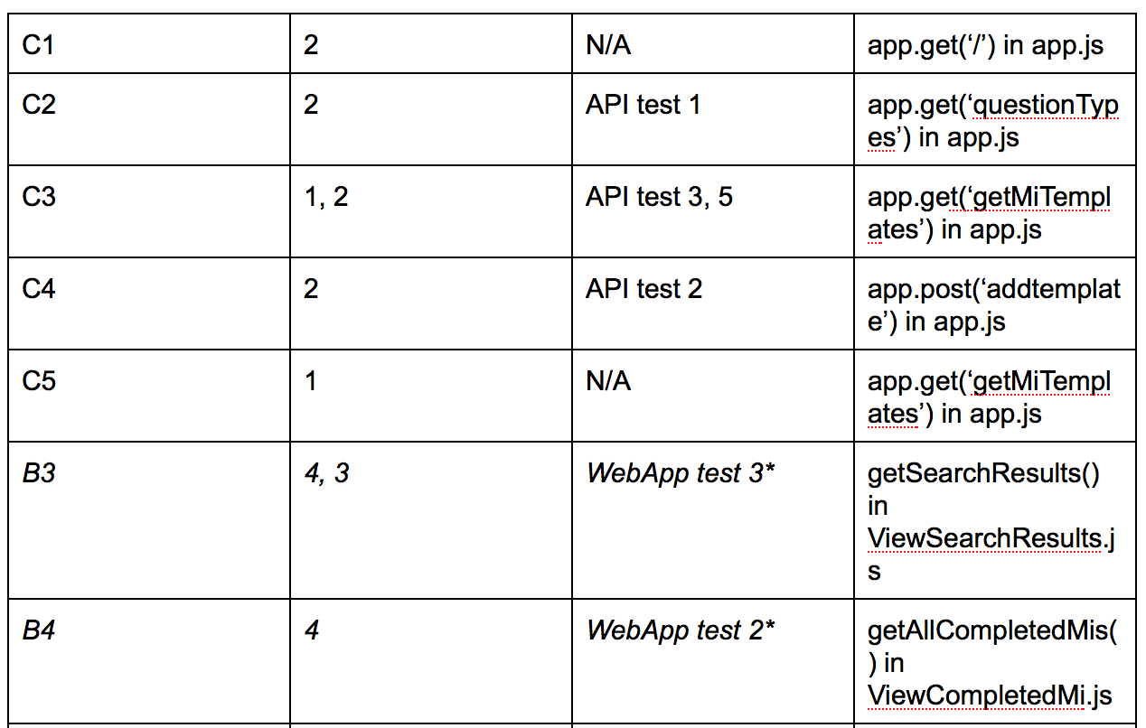
Traceability Matrix
Trace requirements to use cases, specific tests and location in source code
*
20
Notes:
Jag
~ 2 min

Slide 21
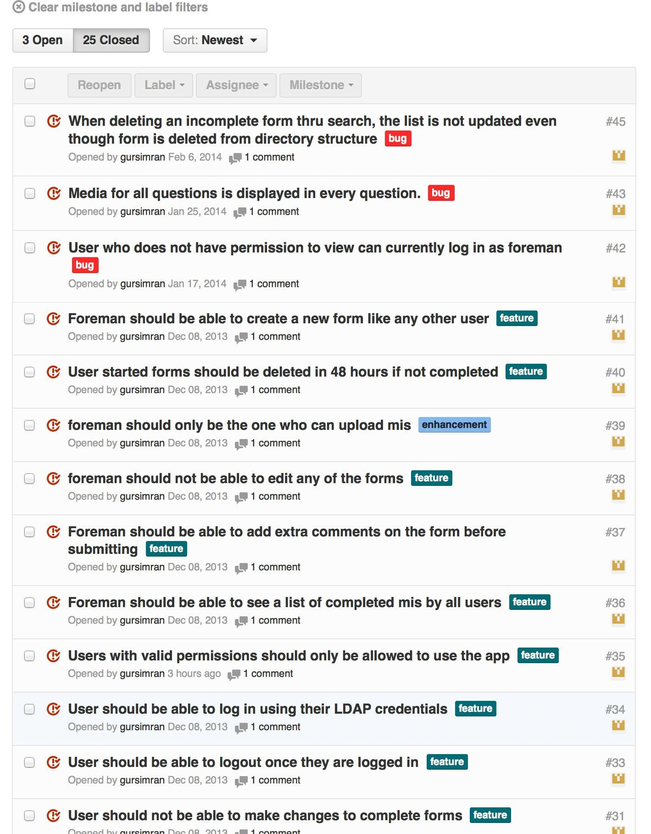
Bug & Issue Tracking

Slide 22
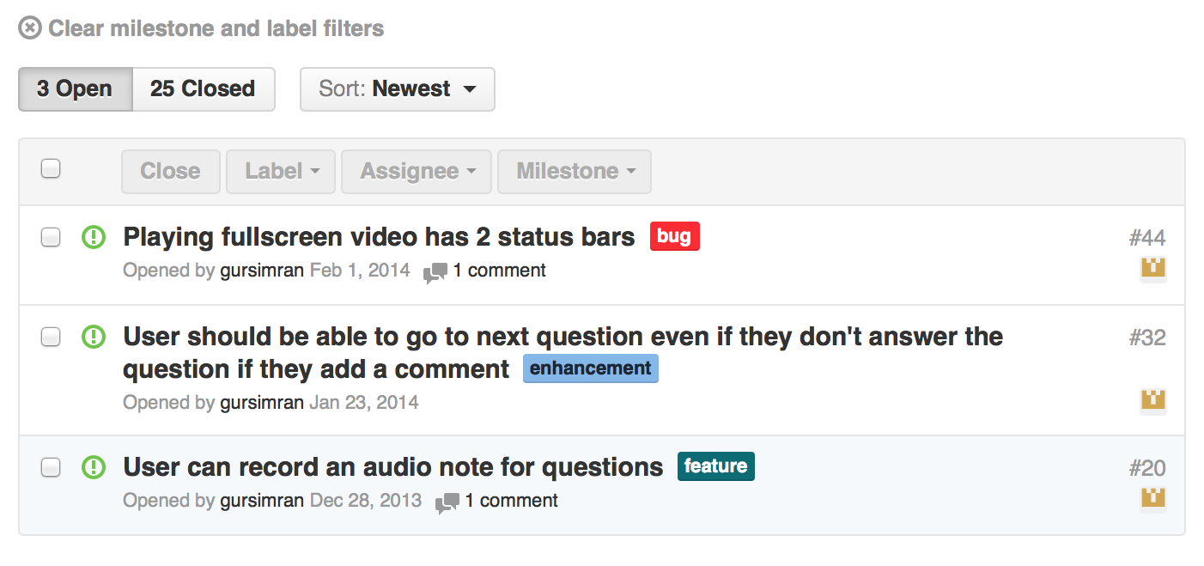
Bug & Issue Tracking

